Slide 1

Private Gullery
Abdallah shehab aldeen

Slide 2
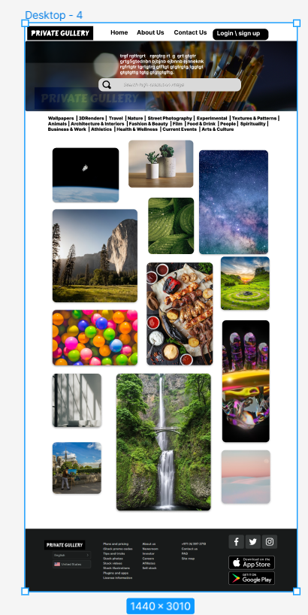
Project overview
The product:
The website to upload distinctive images, the target audience is anyone who wishes to use images free of usage rights "copyright"
Project duration:
Three Days

Slide 3
Project overview
The problem:
There are a lot of users who are afraid to download images from the Internet because of property rights .
The goal:
create a website where you can use images without fear of violating the terms of use, as they are available to everyone.

Slide 4
Project overview
My role:
UX UI designer .
Responsibilities:
user research, wireframing, mockup.

Slide 5
User research
Personas
Problem statements
User journey maps
Understanding
the user

Slide 6
User research: summary
At first, I wanted to create a website to sell HR images, then I noticed that many people suffer from the problem of property rights that control the process of use, then I decided to create a website where the people themselves upload pictures that they took and uploaded for public use.

Slide 7
User research: pain points
1
2
3
4
Pain point
Pain point
Pain point
Pain point
Pictures with the background in slider it is not uncomfortable for the eye, besides that modern website ..
There's no Search bar , This is not good for people who like to use this ,And everyone is in a hurry
Log In \ sign up It's not clear
Accepts all resolution in pictures

Slide 8
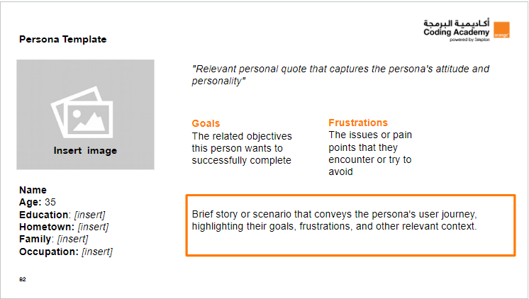
Persona: Name
Problem statement:
[Karim] is a [Persistent / likes to create websites]
who needs []
because [insight].

Slide 9
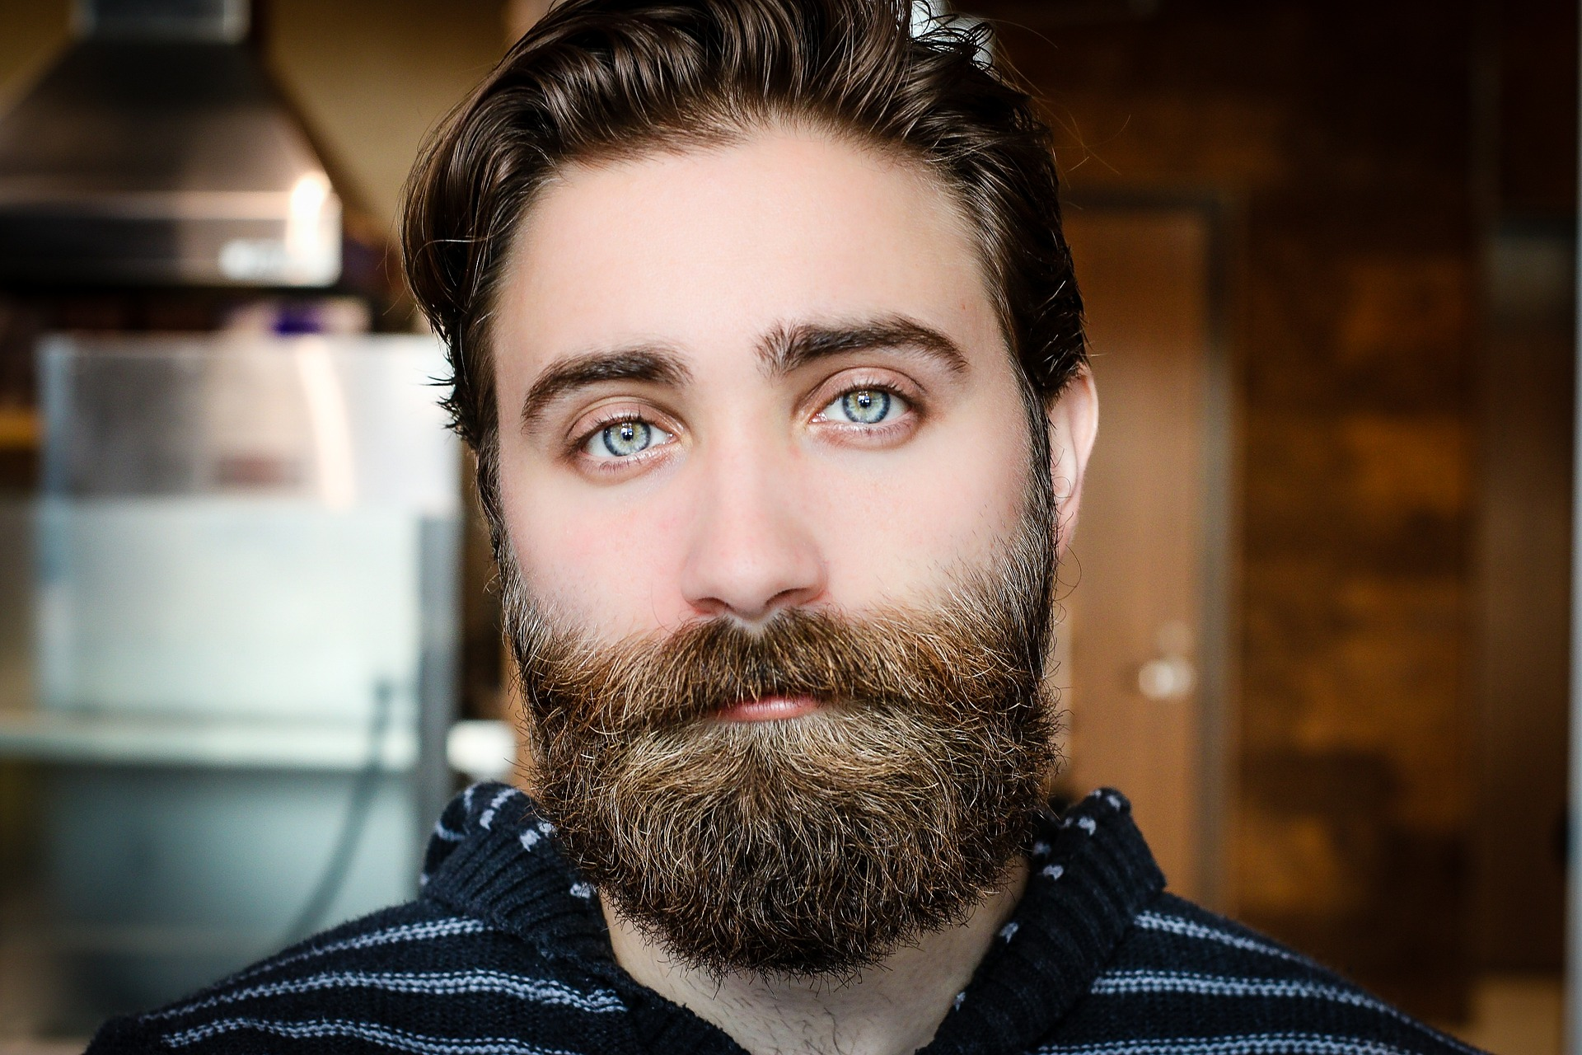

Persona Template
"Karim is UI UX designer and loves his work, he always gets a freelance job offers to creating websites, so he always needs new and pictures for free of usage rights to use them in creating websites"
Goals
Always upload a new High resolution images on the site to always find new and images free of usage rights .
Frustrations
The location of the images on the pages in a comfortable and modern way \ put the login icon in a clear location to make it easy to see \ add Search bar
Insert image
Name
Age: 30
Education: [Great website]
Hometown: [Amman]
Family: [Single]
Occupation: [UI UX Designer]
Karim received a job offer to design a website for airplanes, he needed a lot of high-quality images that can be used without fear of copyright and use, he searched the Internet until he found Private Gullery.COM
and downloaded all the required images with the highest quality

Slide 10
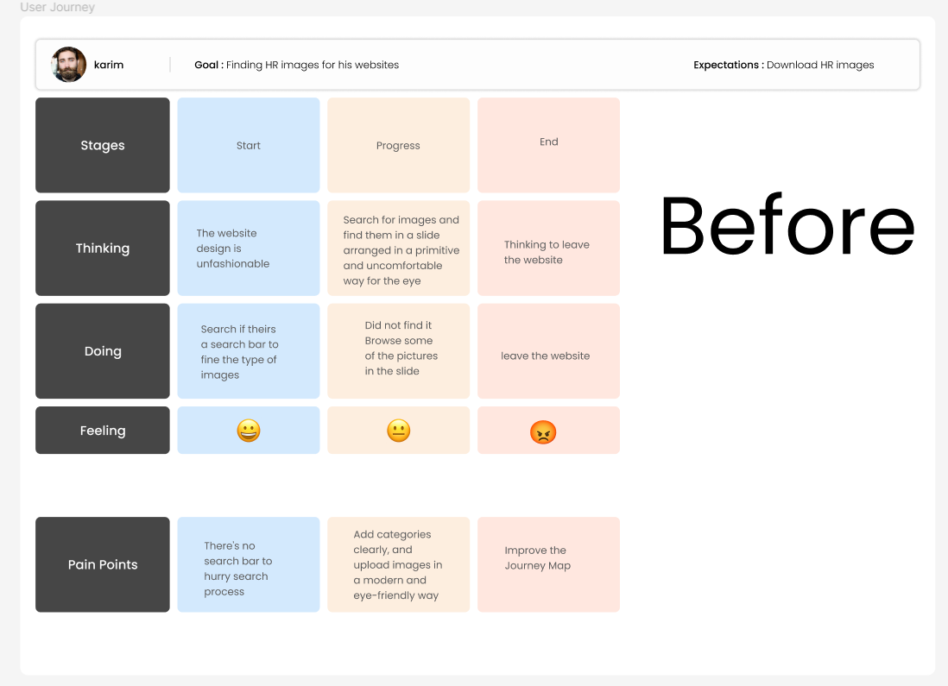
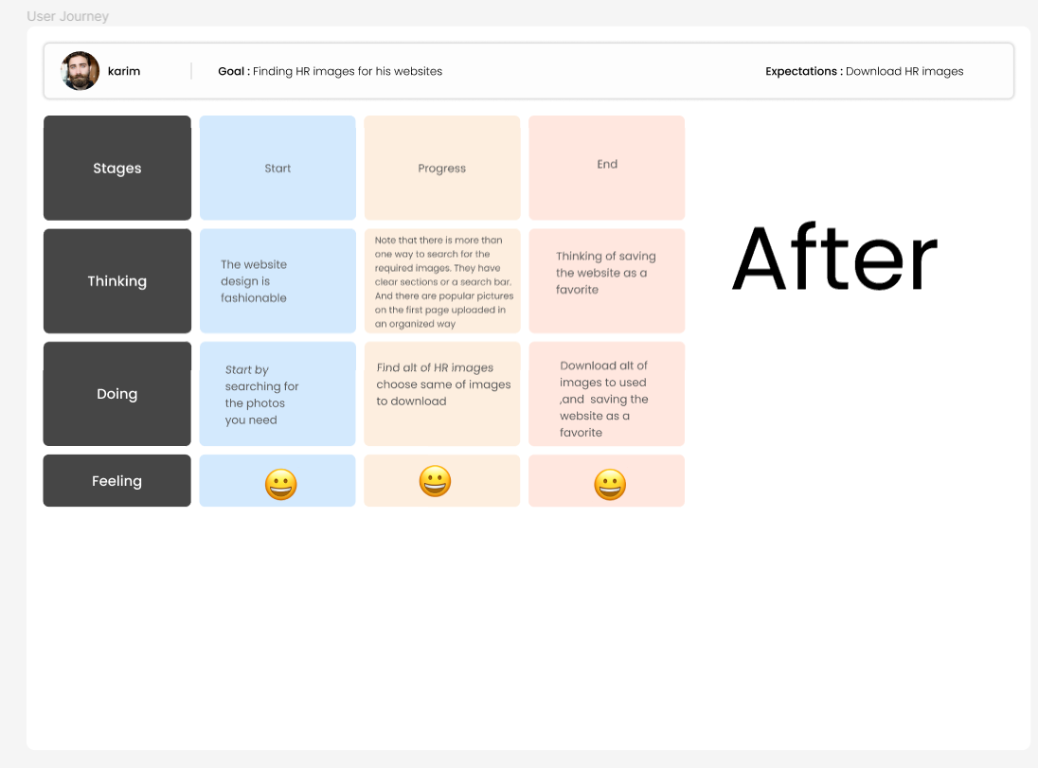
User journey map
[Your notes about goals and thought process]
Image of user journey map

Slide 11
Paper wireframes
Digital wireframes
Low-fidelity prototype
Usability studies
Starting
the design

Slide 12
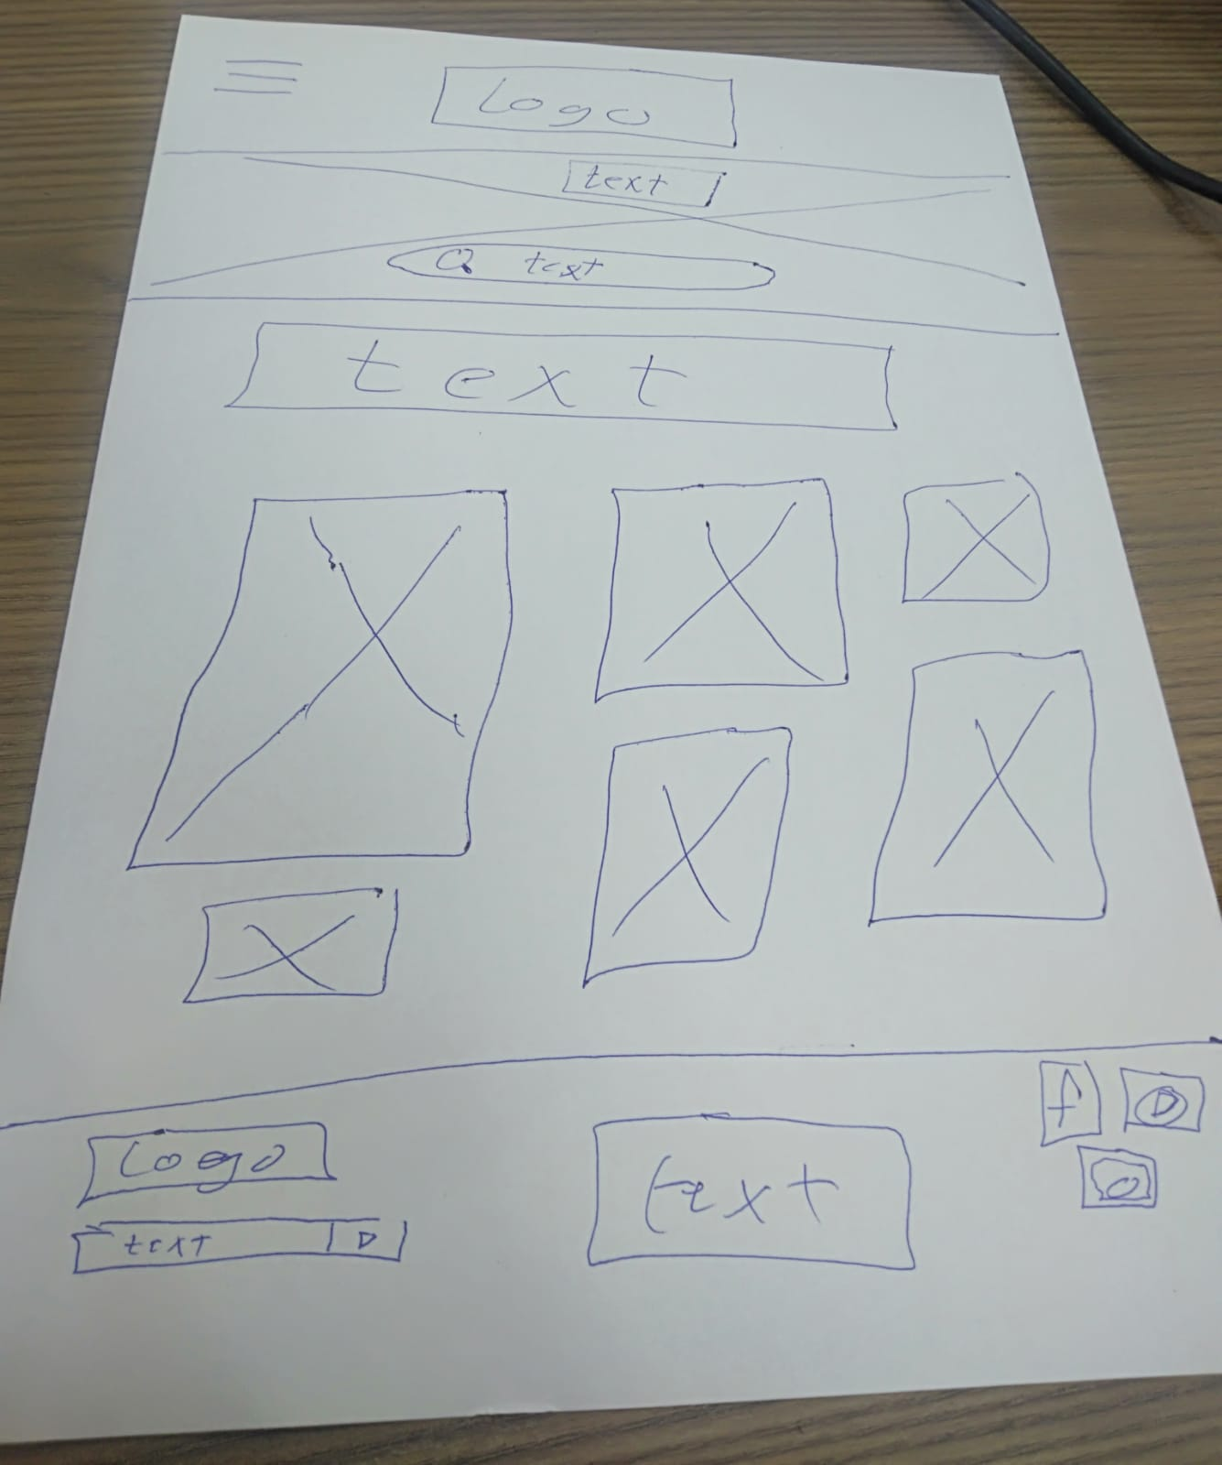
Paper wireframes
[Your notes about goals and thought process]
Image of paper wireframes including five different versions of the same screen and one image of the new, refined version

Slide 13
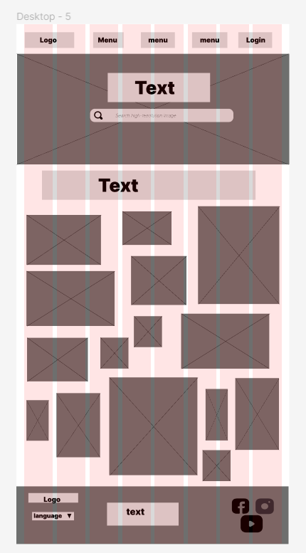
Digital wireframes
[Your notes about goals and thought process]

Slide 14
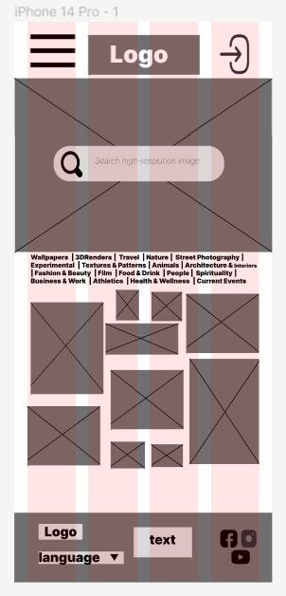
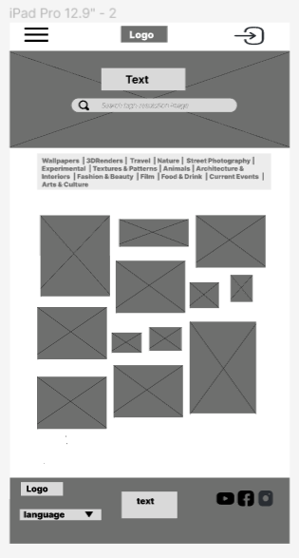
Digital wireframes
[Your notes about goals and thought process]

Slide 15
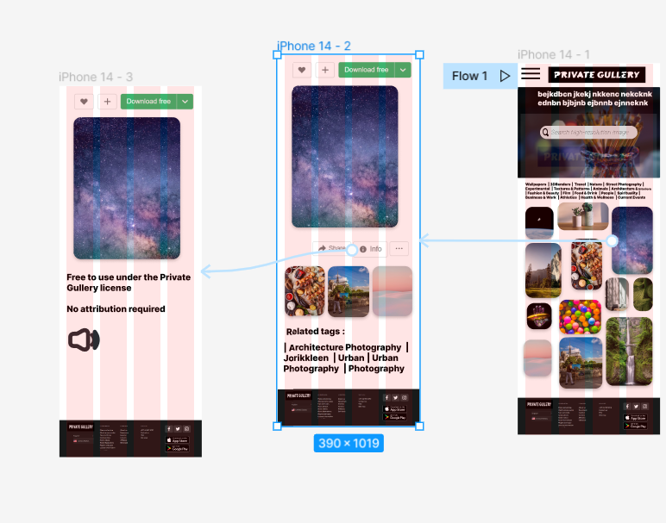
Low-fidelity prototype
[Link to low-fidelity prototype and brief description of the user flow]
Screenshot of prototype with connections or prototype GIF

Slide 16
Usability study: findings
Write a short introduction to the usability studies you conducted and your findings.
Round 1 findings
Round 2 findings
1
Problems in the search mechanism
1
Add search bar
2
Uncomfortable to the eye and primitive design
2
Improve the design to be more modern And easy to show
3
Low resolution images
3
Allow uploading high-resolution images

Slide 17
Refining
the design
Mockups
High-fidelity prototype
Accessibility

Slide 18
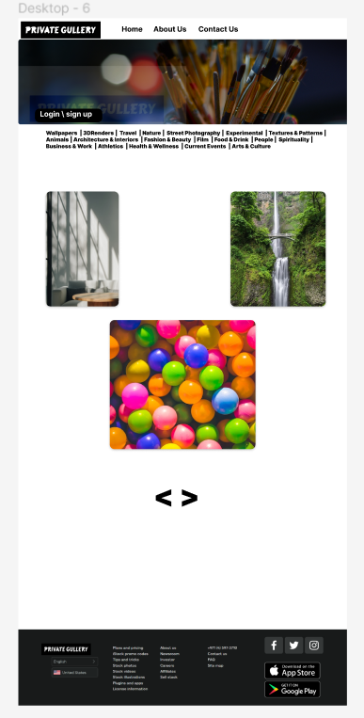
Mockups
Before usability study
After usability study
[Your notes about goals and thought process]
Image of selected screen before usability study
Image of selected screen after usability study

Slide 19
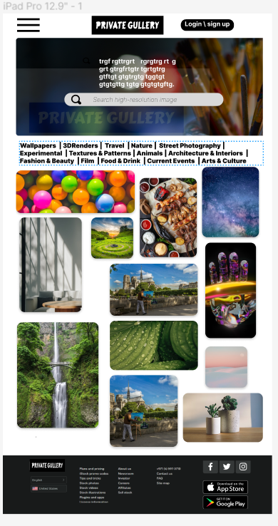
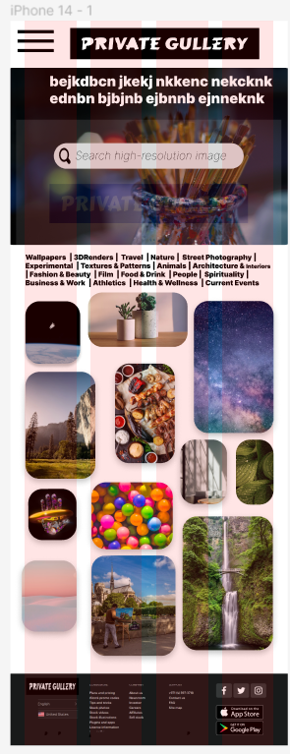
Mockups
Main mockup screen for display
Main mockup screen for display
Main mockup screen for display
Main mockup screen for display

Slide 20
High-fidelity prototype
[https://www.figma.com/proto/mOKou1k1IYsBnZ1y6uCmgE/Untitled?node-id=9-276&scaling=scale-down&page-id=0%3A1&starting-point-node-id=9%3A276 ]
Screenshot of prototype with connections or prototype GIF

Slide 21
Accessibility considerations
1
2
3
Many Languages
Application for App Store Play Store
Add audio feature for people who can't read

Slide 22
Going forward
Takeaways
Next steps

Slide 23
Takeaways
Impact:
The website has provided high quality images ready to download for free.
What I learned:
I learned through the figma website how to design pages on the desktop, iPad and iPhone, including details from Wireframe Mokeup and Prototype.

